Slide 1
Building a Listening Eye
Automated lip reader
Siddharth Raja
John Turner

Slide 2

We aim to make a lip-reader that predicts what a person is saying solely by observing the individual's lip movements.

Slide 3
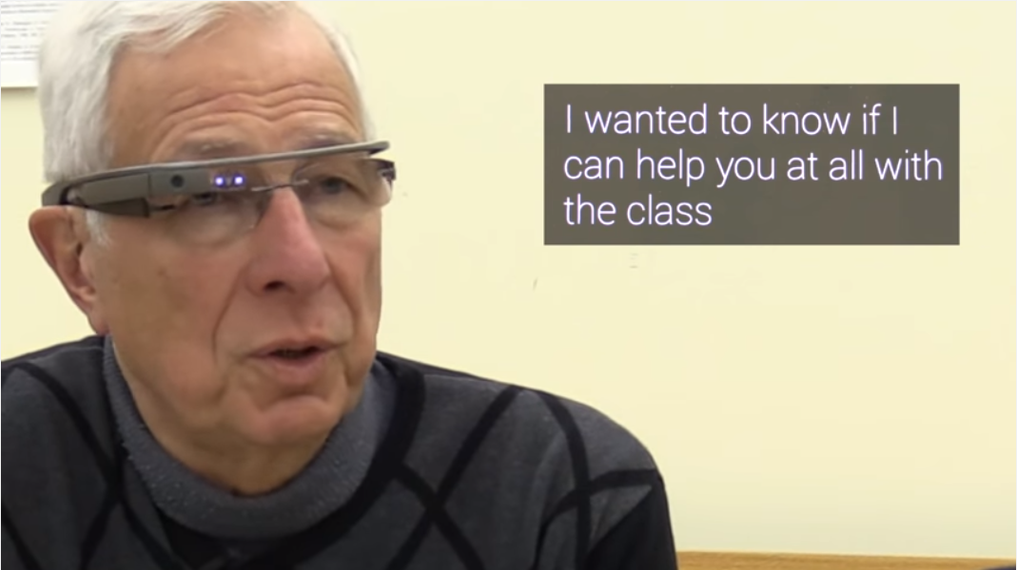
Motivation
It’s a hard problem:
Under constrained (humans make more unique sounds than they do unique lip configurations in spoken English)
Assist the deaf
Example (captioning-on-glass)
https://www.youtube.com/watch?v=s5eXmShC3WE
Current systems are not deployable or usable in any practical application
Human too make use of visual cues to understand speech.

Slide 4
Goals
Presenting captioning for a video
OR
Synthesizing a voice

Slide 5
Related Work
Matthws et al. [1] use HMMs to get about 44.6% accuracy.
‘Eigenlips’ [2]
Hybrid approach of Multi-layered Perceptrons (MLP) and HMMs
Good accuracy but small dataset (around 2500 spoken letters)
‘Multimodal Deep Learning’ [3]
Cross modality feature learning (eg: audio & video)
Long-term Recurrent Convolutional Networks [4]
Combining CNNs and RNNs to solve vision problems with time varying inputs
[1] Matthews, I., Cootes, T. F., Bangham, J. A., Cox, S., & Harvey, R. (2002). Extraction of visual features for lipreading. Pattern Analysis and Machine Intelligence, IEEE Transactions on, 24(2), 198-213.
[2] Bregler, C., & Konig, Y. (1994, April). “Eigenlips” for robust speech recognition. In Acoustics, Speech, and Signal Processing, 1994.
[3] Ngiam, J., Khosla, A., Kim, M., Nam, J., Lee, H., & Ng, A. Y. (2011). Multimodal deep learning. In Proceedings of the 28th international conference on machine learning (ICML-11)
[4] Donahue, Jeffrey, et al. "Long-term recurrent convolutional networks for visual recognition and description." Proceedings of the IEEE Conference on Computer Vision and Pattern Recognition. 2015.

Slide 6
LSTM (Long Short Term Memory)
RNNs needed for arbitrary input sequences and unsegmented data
LSTMs are a better version of RNNs to capture important events with greater time lags
Ability to map variable-length inputs to variable length outputs
Makes short-term memory of RNN slightly longer

Slide 7
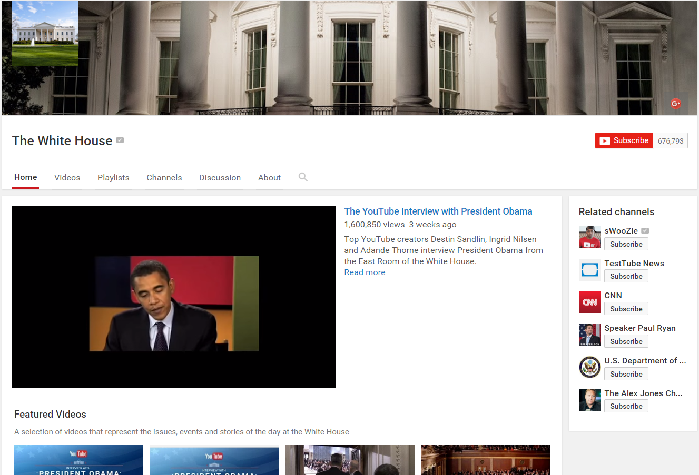
Data Sets
Over 200 video clips from ‘The White House’ YouTube channel.
High Quality
Speaker centered frames
Public Domain data
Eloquent speaker
Thanks Obama!
GRID Dataset by University of Sheffield – but not a huge corpus (34 sentences)

Slide 8
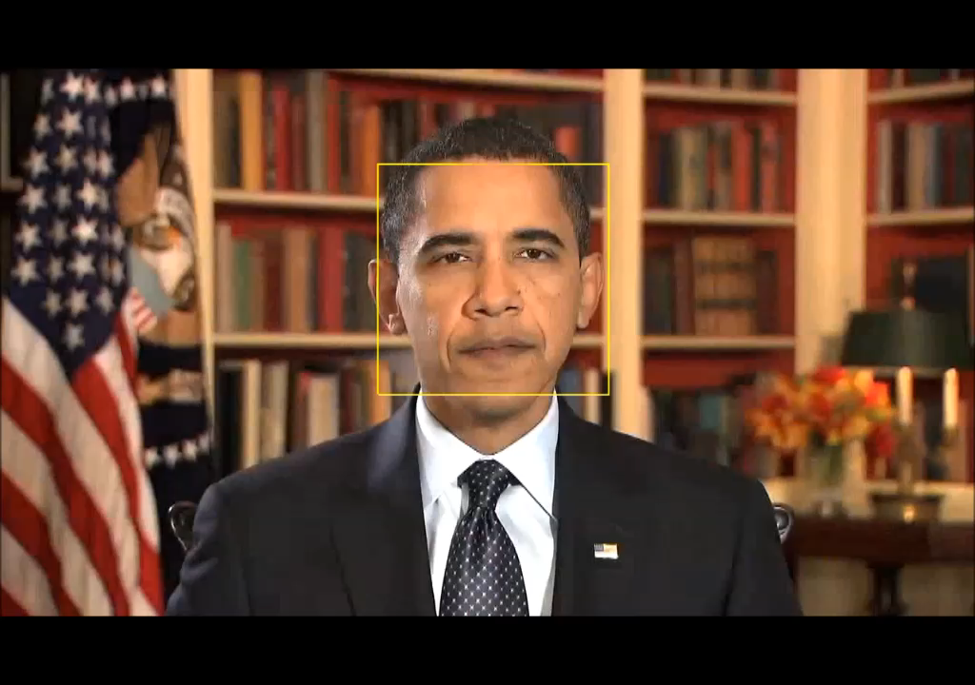

Slide 9
Initial Approach
Isolate the heads / mouths in the talking head videos
Use these smaller sections cropped from the videos to create a sequence of frames that is fed into a Long Term Recurrent Net

Slide 10
Thank You!
Questions?

